Slide 1



A Project Presentation On Gen-Z’s Career Aspirations
&
Key Findings
Presented by : Rachit Gupta (Data Analyst Intern)

Slide 2










Implementation Plan
Business Research Documentation
Data Cleaning
Overview Dashboard
Presentation
Problem Statement
Data Collection
Data Analyzing
Main Dashboards

Slide 3

AGENDA
1. Introduction
Project Overview
2. Survey & Dataset
3. Objective
4. Methodology Used
Data Collection
Data Analysis
Visualization
5. Data Visualization
6. Findings and Insights
7. Recommendations for Stakeholders
8. Conclusion & Next Steps

Slide 4


1. Introduction
Project Overview
Objective: Understanding career preferences and aspirations of Gen-Z professionals.
Scope: Data analysis on Gen-Z job preferences, industry choices, and workplace expectations.
Data Source: Extracted from Kulture hire database .
Key Deliverables: Trends, career patterns, and recommendations for hiring strategies.

Slide 5


2. Survey & Dataset
The survey was designed to capture diverse insights from Gen Z professionals across different demographics and geographic locations. It was structured to include both qualitative and quantitative responses, focusing on understanding their aspirations, preferences, and motivations.
Respondent Demographics:
Geography: The majority of responses were from India.
Gender: Included a balanced representation of male, female, and other genders, ensuring inclusivity.
Age Group: Targeted primarily at Gen Z individuals (18–26 years).
This design ensures a robust representation of the Gen Z cohort, providing a reliable foundation for actionable insights.

Slide 6
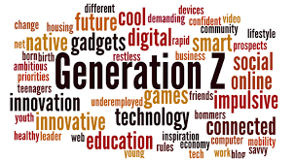
2. Survey & Dataset
The dataset consists of 1,20,303 rows, with a variety of columns that captured crucial aspects, including:
Career Preferences: Top career choices and influencing factors.
Learning Aspirations: Preferred learning environments, aspirations for higher education, and key influences.
Managerial Expectations: Qualities desired in ideal managers and leadership preferences.
Mission Alignment: The role of organizational mission clarity in fostering employee satisfaction.
Workplace Trends: Willingness to work under challenging circumstances, remote work preferences, and tenure expectations.
This rich dataset enabled detailed analysis to uncover Gen Z’s career aspirations and workplace expectations.

Slide 7

3. Objective
Identify Learning Aspirations: Understand Gen Z’s preferred learning modes, influencing factors, and higher education goals.
Explore Leadership Preferences: Highlight the managerial qualities Gen Z values for an optimal work environment.
Examine Mission Alignment: Assess the importance of mission clarity in driving employee satisfaction and engagement.
Deliver Actionable Insights: Provide recommendations to help businesses adapt their strategies to Gen Z’s career expectations.

Slide 8

4. Methodology Used
Data Collection: Extracted from Kulture hire database containing 1,20,00+ career preferences from Gen-Z professionals
Cleaned and processed using Excel and SQL queries.
Data Analysis: Identified patterns and trends using statistical methods Exploratory Data Analysis (EDA) for insights.
Visualization: Created charts, graphs, and dashboards for better interpretation using Excel and Power BI.

Slide 9
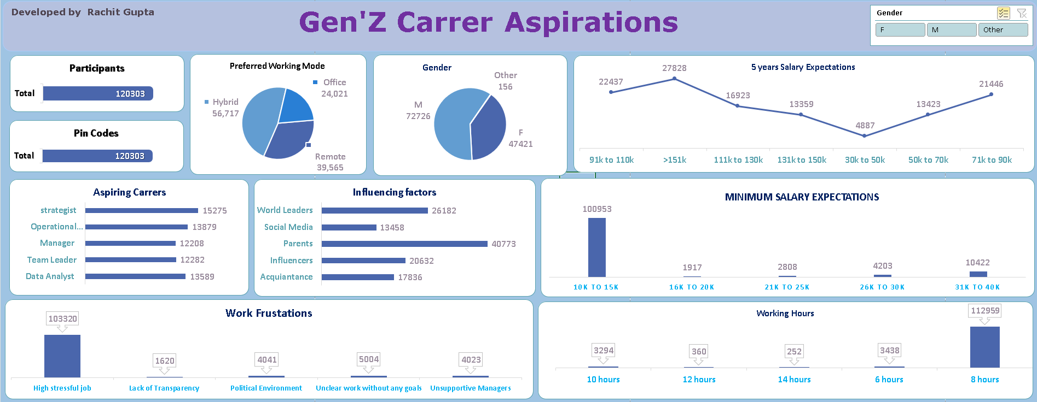
5. Data Visualization Using Excel

Slide 10
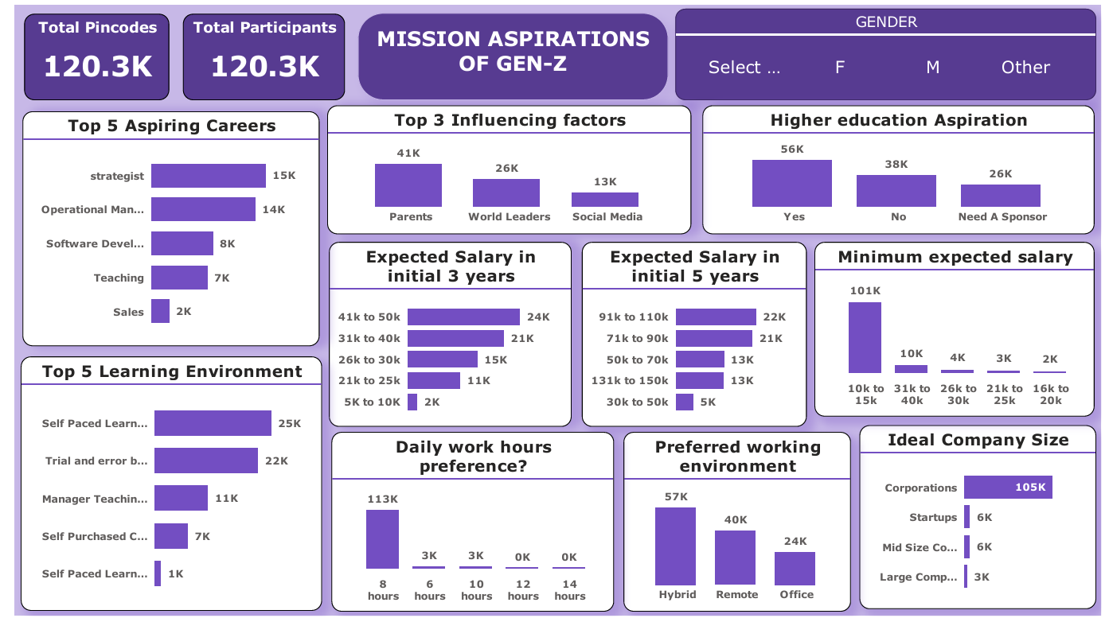
5. Data Visualization Using Power Bi

Slide 11
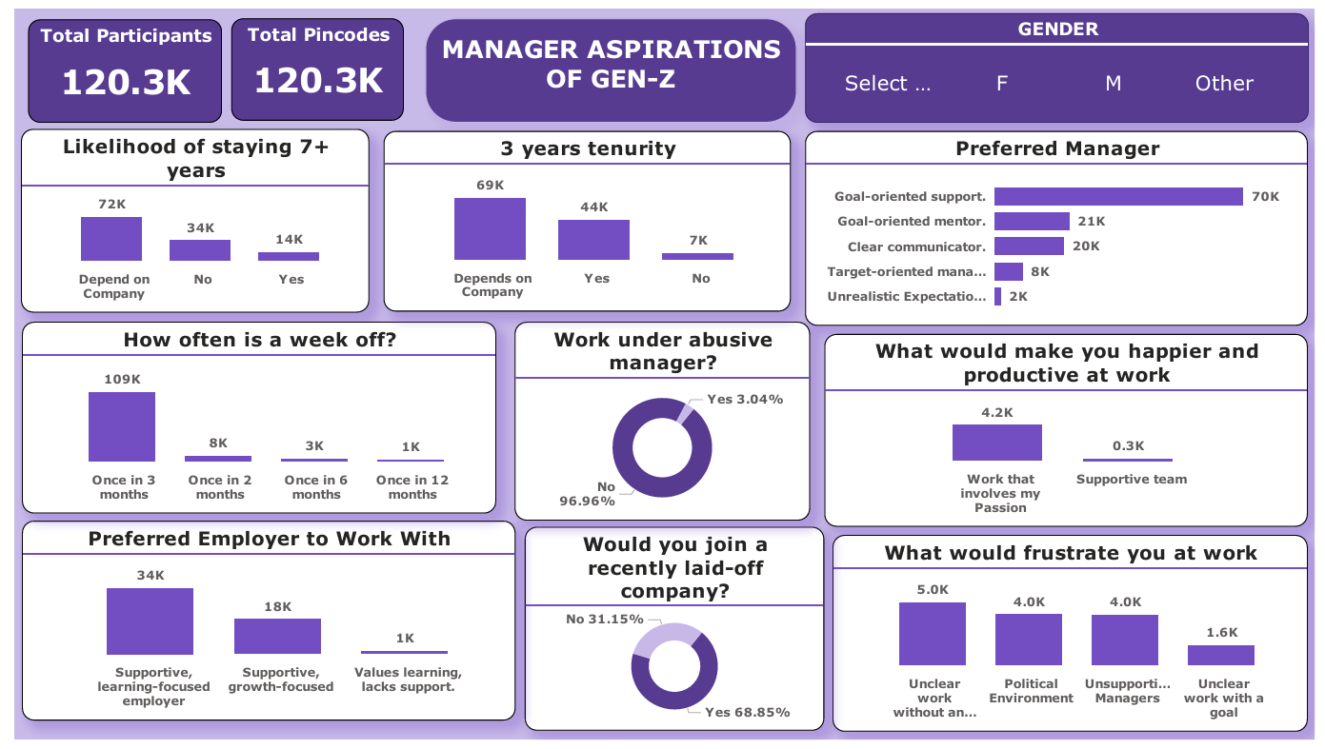
5. Data Visualization Using Power Bi

Slide 12

6. Findings and Insights
The analysis of Gen Z’s career aspirations and workplace expectations revealed several important trends:
Learning Aspirations:
A strong preference for structured yet flexible learning environments, with Expert-Led Programs as the top choice.
67.65% aspire to higher education, but affordability remains a key concern for a significant portion.
Career Preferences:
Gen Z is drawn to creative, analytical, and management-focused roles, with Design & Strategy, Data Analytics, and Business Operations dominating career choices.
Traditional industries like Cybersecurity, BPO Services, and Sales & Marketing are less favored.
Managerial Expectations:
Employees value managers who provide clear goals, supportive leadership, and transparency, emphasizing the need for structured leadership practices.
Mission Alignment:
Misaligned missions lead to frustrations like unclear goals and lack of transparency, highlighting the critical importance of organizational clarity.
Workplace Trends:
The majority are open to long-term tenure when organizations prioritize mission alignment and transparency, demonstrating resilience and adaptability.
These findings offer valuable insights into Gen Z’s priorities, enabling organizations to align their strategies for attracting and retaining young talent effectively.

Slide 13
6. Findings and Insights
✔ Hybrid work is the most preferred mode (47%), while only 20% prefer working from the
office. ✔ Parents (34%) are the most influential factor in career choices, followed by world leaders
(22%). ✔ Most participants expect a salary between 91K-110K after 5 years (19%), but a significant
23% expect more than 151K. ✔ 84% expect a minimum salary of 10K-15K, indicating conservative expectations in the early
years. ✔ High-stress jobs (86%) are the biggest work frustration, followed by unclear goals (4%). ✔ 94% prefer an 8-hour workday, with minimal interest in extended hours. ✔ 58% want a goal-oriented supportive manager, while 7% work under target-driven
leadership. ✔ 60% are open to staying at a company for more than 7 years, but it depends on the work
environment. ✔ 96.96% refuse to work under abusive managers, emphasizing the importance of a healthy
work culture.

Slide 14
7. Recommendations for Stakeholders
Foster Transparent Leadership:
Cultivate clear communication channels and set well-defined goals to enhance employee trust and satisfaction.
Invest in Learning Opportunities:
Offer expert-led programs, self-paced learning, and observation-based training to meet Gen Z’s diverse learning preferences.
Support Higher Education Aspirations:
Provide sponsorships or education assistance programs to address affordability concerns and encourage skill development.
Align Organizational Mission:
Ensure the company’s mission aligns with employees’ values to reduce frustrations and foster loyalty.
Create Rewarding Work Environments:
Balance high-pressure tasks with meaningful rewards and learning-focused support to drive engagement and professional growth.
By implementing these strategies, organizations can establish themselves as employers of choice, effectively meeting the aspirations and expectations of Gen Z talent.

Slide 15
8. Conclusion & Next Steps
The analysis of Gen Z's career aspirations and workplace expectations highlights the generation's focus on
Structured learning,
Supportive leadership
Mission-driven work environments.
Gen Z seeks careers that blend creativity, analytical thinking, and management while prioritizing transparency and alignment with organizational goals.
Their resilience and adaptability are evident, but factors like affordability, clarity, and trust significantly influence their decisions regarding education and employment.
These insights can guide organizations in tailoring strategies to attract and retain this dynamic workforce.

Slide 16
8. Conclusion & Next Steps
Summary: Gen-Z career aspirations align with flexibility, growth, and digital skills Companies must adapt hiring and retention strategies accordingly
Next Steps: Conduct deeper analysis on career transitions over time Implement AI-driven hiring recommendations to streamline recruitment Collaborate with organizations to improve workplace policies based on findings
PLEASE PROVIDE FEEDBACK ON THIS PRESENTATION

Slide 17


Thank you
Open for questions and discussions
Rachit Gupta (Data Analyst Intern)
rachitgupta8534@gmail.com
LinkedIn
www.kulturehire.com

